Slide 1
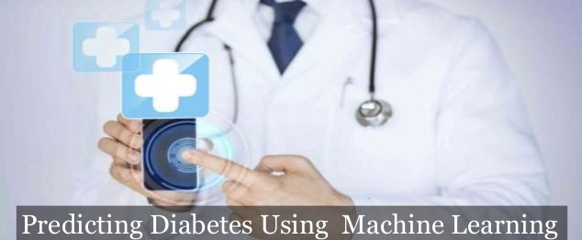
EARLY PREDICTION OF PRE-DIABETES USING MACHINE LEARNING
Prepared By:
Neha Joisher (Roll No.44)
Malav Shah (Roll No.62)
Pujan Sheth (Roll No.65)
Under the guidance of:
Prof. Radhika Kotecha

Slide 2
OVERVIEW
Introduction
Objectives / Goals
Existing System
Proposed System
Implementation
Conclusion and Future Plan of Work
References

Slide 3
INTRODUCTION
Diabetes mellitus (DM) a.k.a Diabetes is a chronic and lifestyle disease and millions of people from all over the world fall victim to it.
According to IDF (International Diabetes Federation), 77 million Indians (8.9% of total adult population) are affected by diabetes, due to lack of knowledge millions of Indians are passing every year.
With the advancement of information technologies, mobile health (mHealth) technologies can be leveraged for patient self-management, patient diagnosis and determining the probability of being affected by some disease.

Slide 4
OBJECTIVES
The aim of developing the healthcare application is to help people to maintain their health.
To predict the diabetic risk level of a patient with a higher accuracy.
For prediction, we are focusing on selected attributes that ail in early detection of Diabetes Mellitus using Predictive analysis.
To assess the association of various risk factors with prediabetes.

Slide 5
EXISTING SYSTEM
People staying in urban region are very health conscious compare to the ones who stays in rural region. At every certain interval of time they go for checkup to test whether they are suffering from any diseases or not.
Although acquiring awareness about diabetes is a crucial issue, but, to the best of our knowledge, there are no real-world tools that helps to develop this awareness for the masses at an individual level.

Slide 6
PROPOSED SYSTEM
The system takes age, glucose, blood pressure, height and weight to calculate BMI, as input from user.
After getting input from the user, it will process data and apply machine learning algorithm on it. The system will predict whether the user will suffer from diabetes or not.
We also suggest healthy tips to users which will help them to control the sugar level and help people to stay away from diabetes.

Slide 7
COMPARISON BETWEEN EXISTING AND PROPOSED SYSTEM
EXISTING SYSTEM | PROPOSED SYSTEM
Currently the existing systems are not able to predict diabetes. They just state whether a person is suffering from diabetes or not. | In our proposed system we aim to predict whether a person is suffering from diabetes or not or in how much time down the line he/she will be suffering from it.
The existing systems do not provide suggestions or tips for preventing diabetes. | The proposed systems do provide suggestions or tips for preventing diabetes.
There is no such system that provides features like target heart rate, Blood volume ,Calorie level ,Diabetes, Healthy tips all together. | Our system provides features like target heart rate, Blood volume, Calorie level, Diabetes, Healthy tips all together.

Slide 8
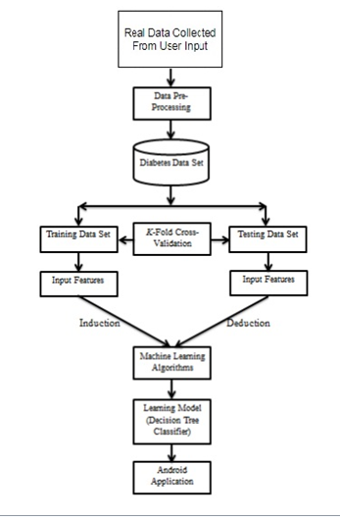
FIG 1 : FLOW DIAGRAM OF PROPOSED SYSTEM

Slide 9
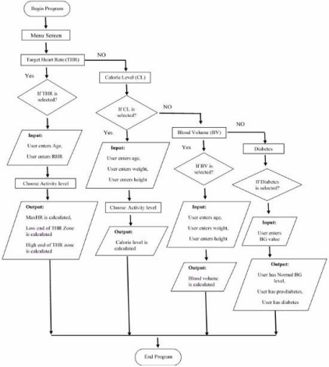
FIG 2 : FLOW DIAGRAM OF ANDROID SYSTEM

Slide 10
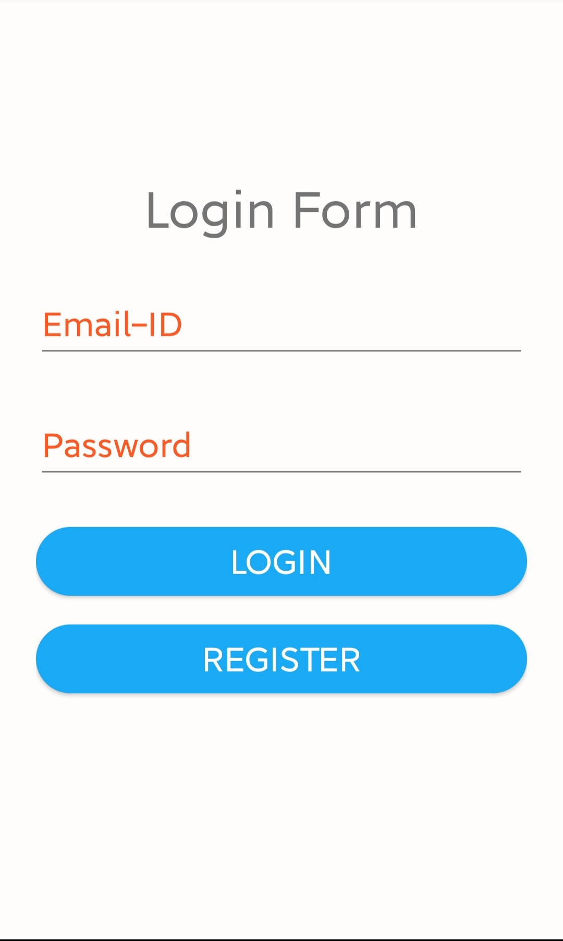
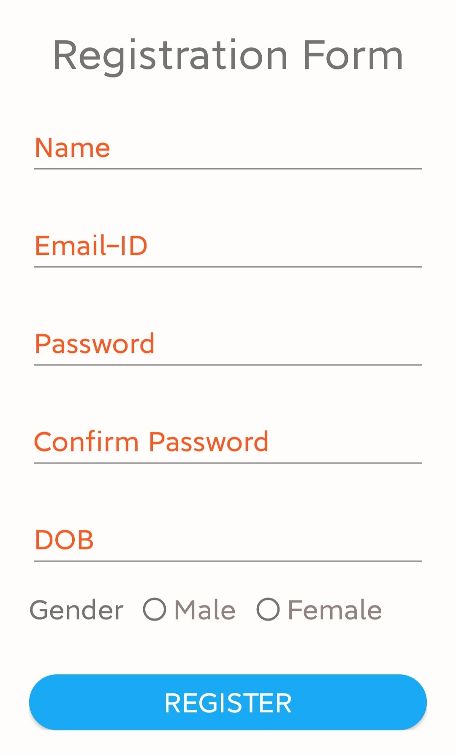
IMPLEMENTATION - I

Slide 11
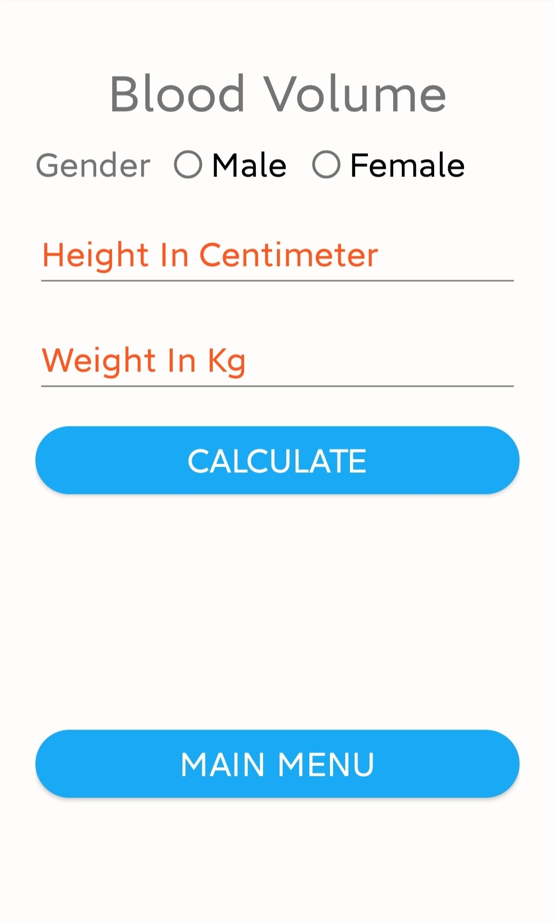
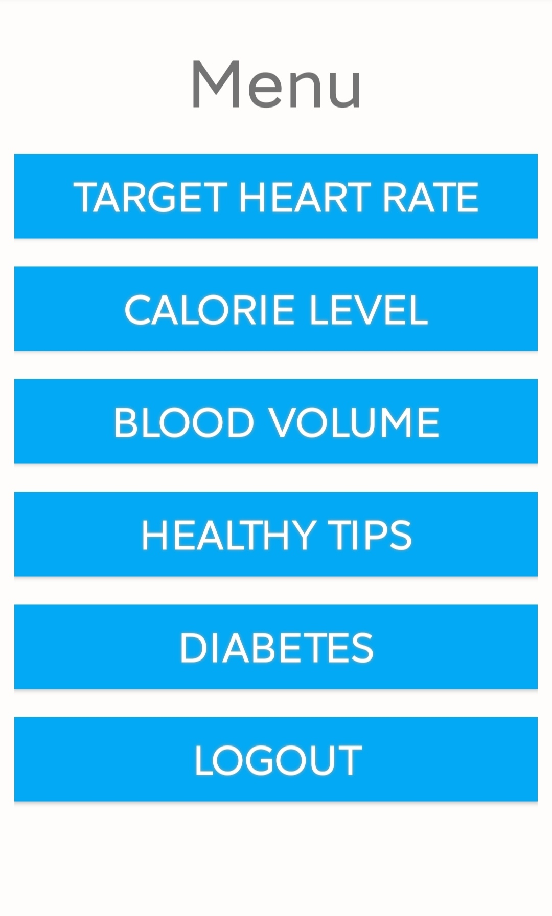
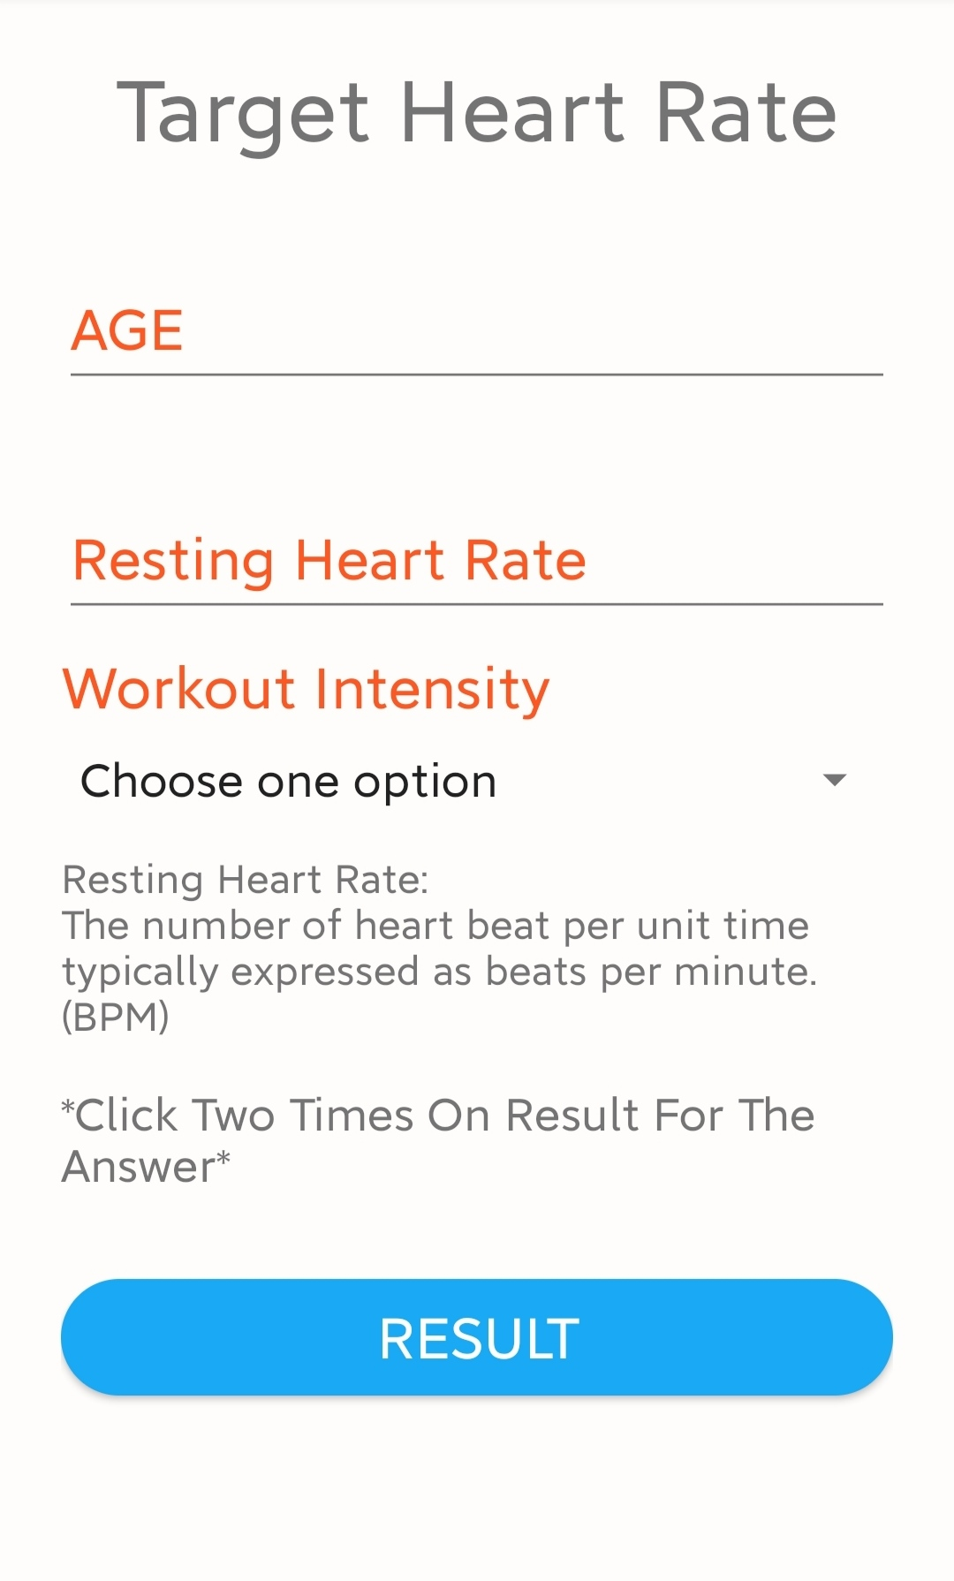
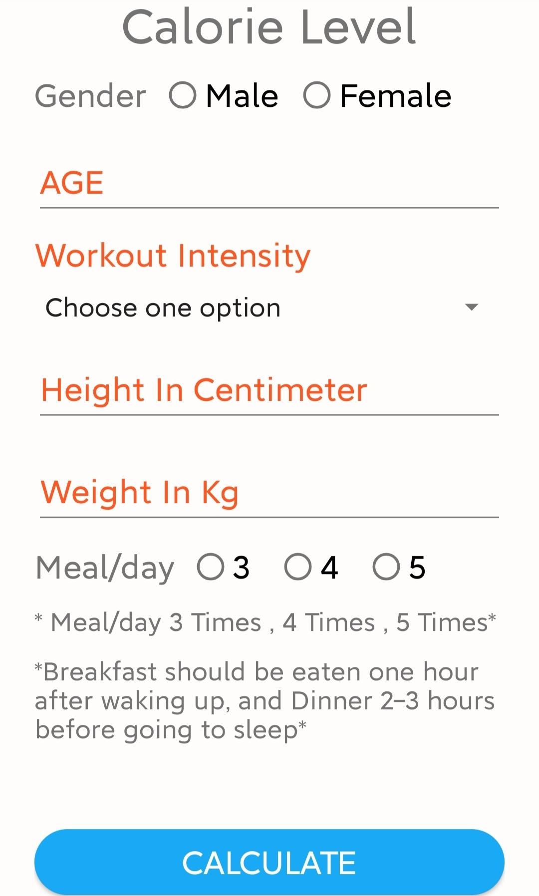
IMPLEMENTATION - II

Slide 12
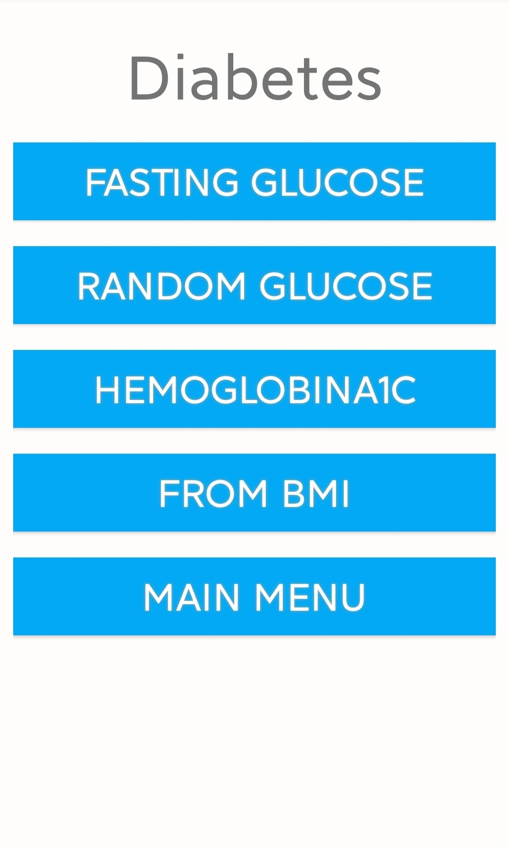
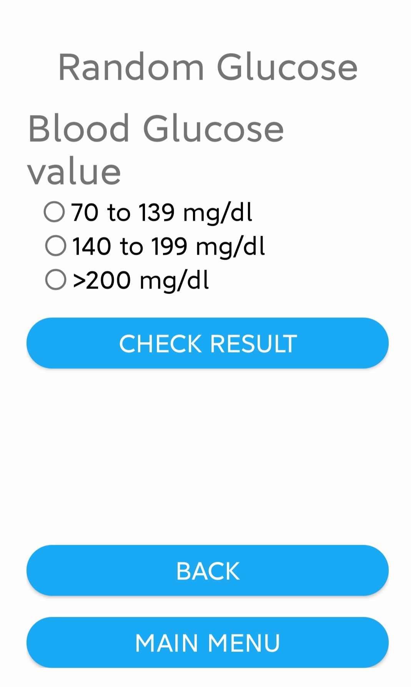
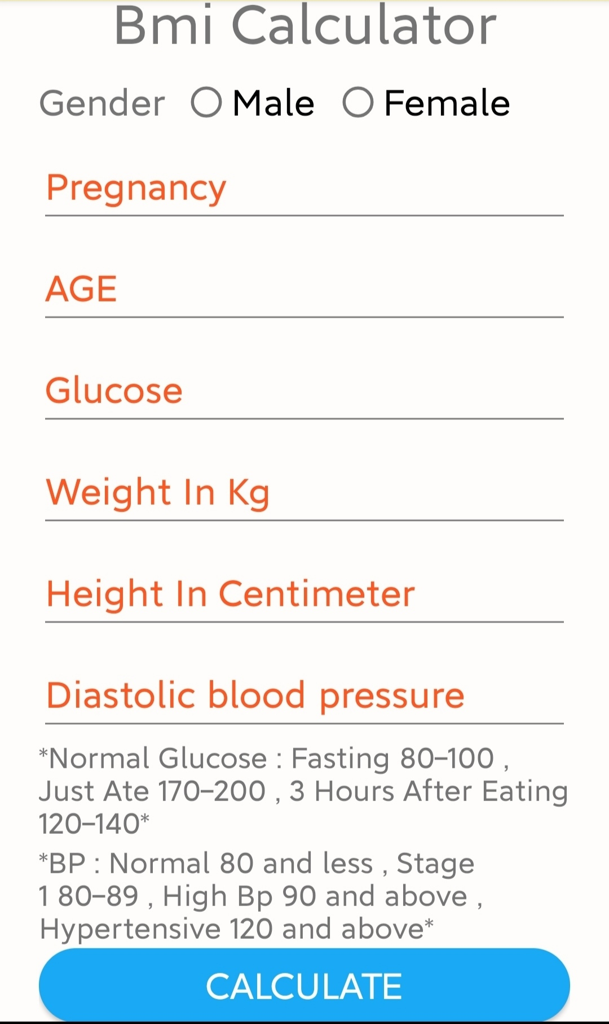
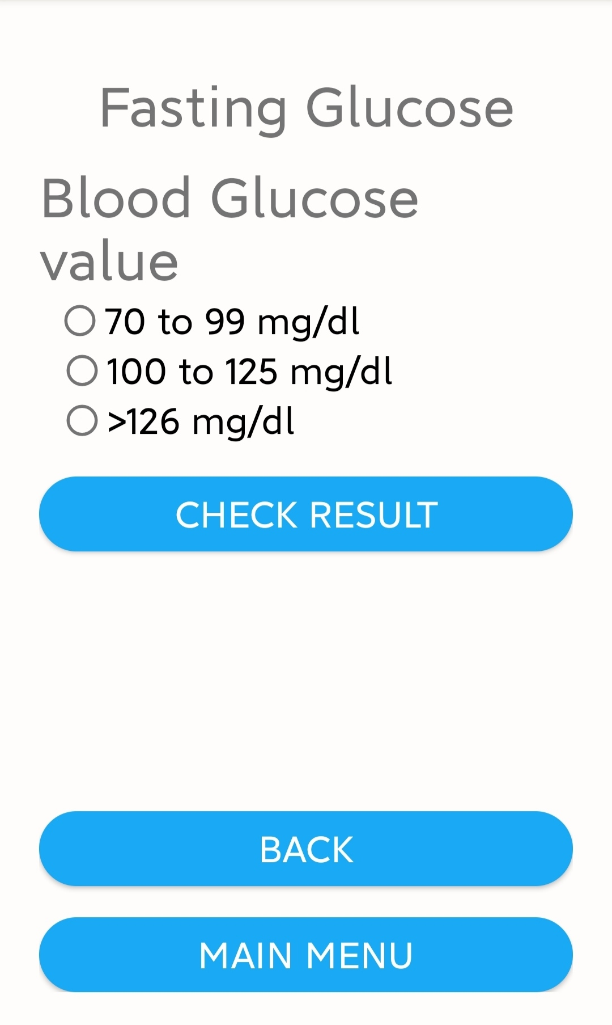
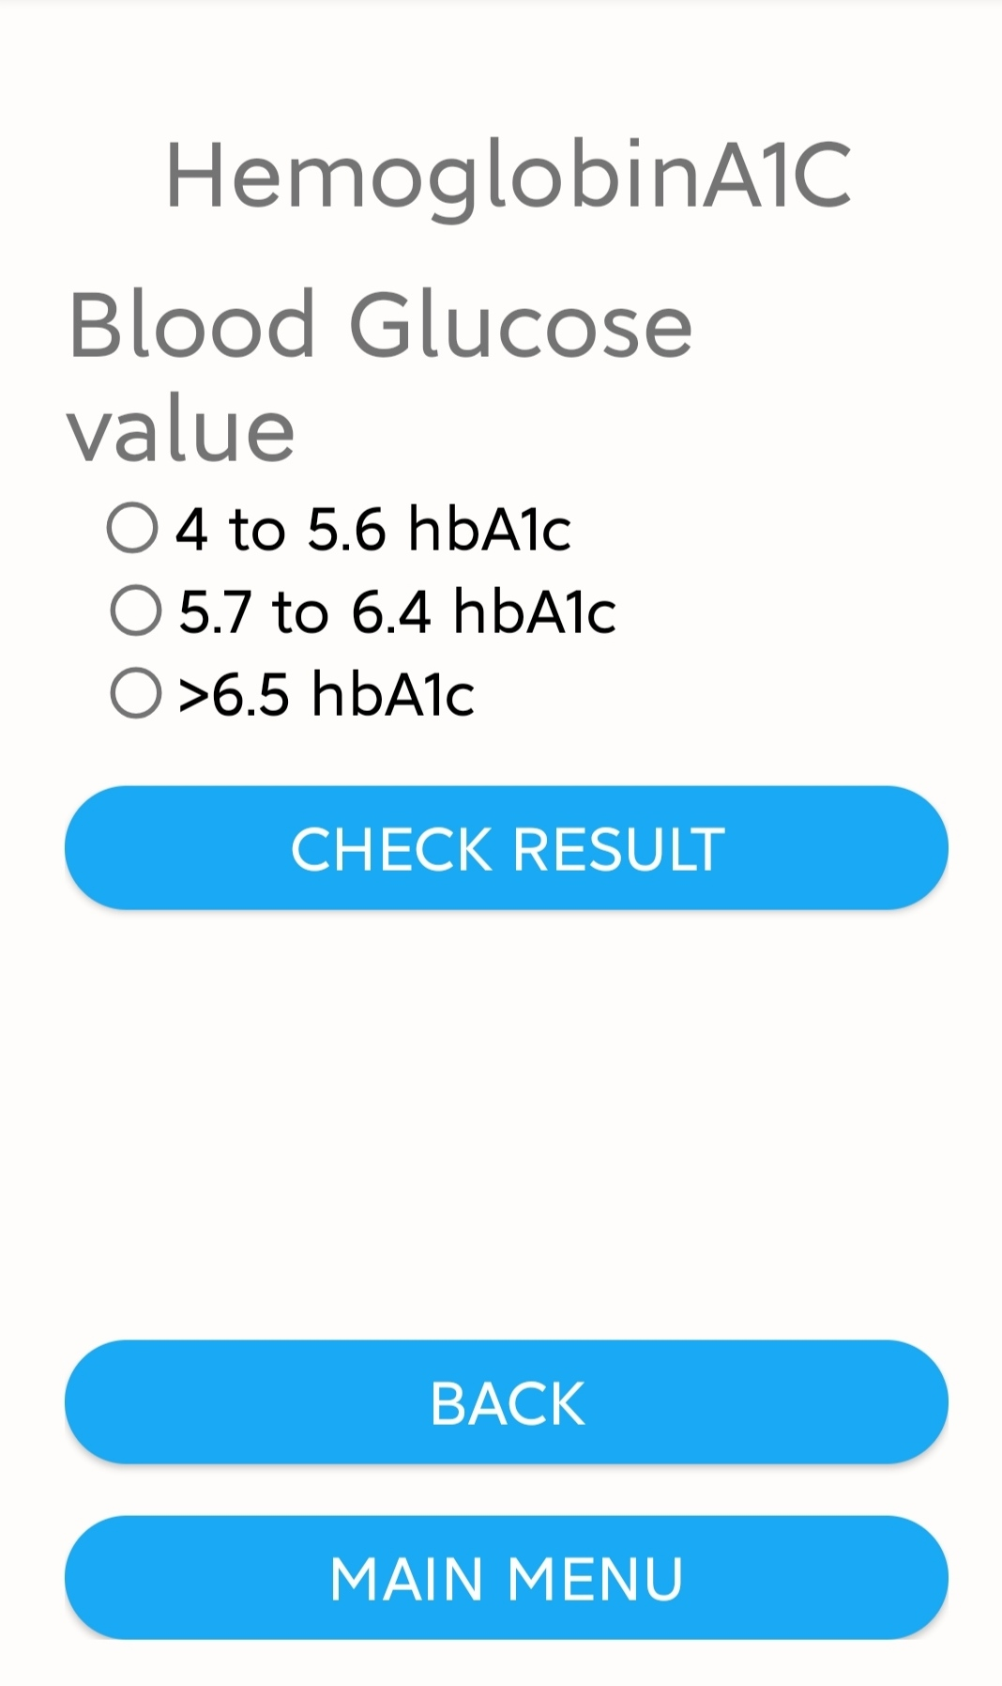
IMPLEMENTATION - III

Slide 13
CONCLUSION
The aim of developing the healthcare application is to help people to maintain their health. There are five functionalities in application (1)Target heart rate (2) calorie level (3) blood volume (4)diabetes and (5) Healthy tips.
After collecting diagnostic dataset with 9 diabetic attributes of 768 patients for the study we were able to predict diabetes with good accuracy.
Based on its testing accuracy, we compared and analysed five machine learning algorithms out of which SVM algorithm has highest accuracy.

Slide 14
FUTURE WORK
Provide reminders to users about their medications which help them to take medicine on time. Therefore, through these reminders, the user can take care of their health.
Graphs of the output obtained will help the user to keep track of the changes in diabetes-related readings and to manage their diet and health in a more effective way.

Slide 15
REFERENCES
A. Singhal , K. Sowjanya and C. choudhary , “MobDBTest: A machine learning based system for predicting diabetes risk using mobile devices,” In 2015 International Advance Computing Conference (IACC) IEEE, pp. 397-402, 2015
H. Abbas, L. Alic, M. Rios, M. Abdul-Ghani and K. Qaraqe, "Predicting Diabetes in Healthy Population through Machine Learning," In 2019 IEEE 32nd International Symposium on Computer-Based Medical Systems (CBMS), IEEE, pp. 567-570, June 2019.

Slide 16
THANK YOU

